Slide 1
Deep Learning in NLP
Many slides adapted from Richard Socher, Tom Mitchell

Slide 44
Recurrent Neural Network Language Models

Slide 54
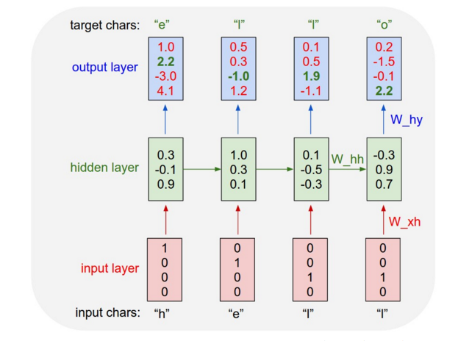

Slide 55
Summary
Deep learning is a popular area in machine learning recently
Very successful in speech recognition and computer vision
Becoming very popular in NLP these days
Main motivation:
Learn feature representations from data
Alternative to hand-engineered features
Neural networks:
Primary deep learning approach
Layers of logistic regressions – can directly calculate gradients from outputs
Nonlinear decision boundaries

